Slide 1
Employee Segmentation Clustering
Modelling objective:
1. Identify the groups of target employees, as well as suggest relevant employee retention strategies/recommendations to be taken so as to reduce **attrition rates** in the company, thereby improving workforce productivity.
2. Tap on unsupervised clustering machine learning algorithms to achieve `employee segmentation` such that we have clear understanding of the employee segments
Lim Hur 2112589
DAAA2A02

Slide 2

Problem understanding and background research
As a HR manager, you want to understand your employees so that appropriate direction can be given to the management to satisfy and retain the employees
To begin, we need to understand why employees leave?
According to the Manpower research and statistics department (Singapore), given the impact Covid-19 has on the labour market, there was an observed increase of annual average resignation rates of 1.8% in 2021, from a previous 1.5%, which is almost as high as the recruitment rate. [4] This shows that given the impact covid-19 has on the economy, employees are leaving due to the economic downturn. This is certainly worrying and we will explore the negative consequences of such a phenomenom.
There are many reasons for employee turnover, this includes: economic downturn, bad company management, unhealthy working environment, better prospects in another organization in terms of career growth, etc. Employees also may feel that their work is not what they imagined, or perhaps may feel devalued, and unrecognized. [2]

Slide 3
Understanding the bane of employee turnover
Employee turnover is a huge problem for companies. The true cost of replacing an employee can often be quite large. This cost can be also known as turnover costs
Cost of turnover refers to expenses both tangible or intangible associated with replacing an employee. Turnover costs include expenses like: unemployment compensation, time and materials for new hire. [7]
A report produced by Center for American Progress discovered that for all positions, except for executives and physicians jobs that require very specific skills, the typical median cost of turnover was 21% of an employee’s annual salary. Furthermore, for workers earning less than 50,000 dollars annually which consists of 75% of the workers in the US, case studies show a typical cost of turnover of 20 percent of salary, the same as across positions earning $75,000 a year or less, which includes 9 in 10 U.S. workers. [1]

Slide 4
Understanding the bane of employee turnover
Similarly, according to Organization Science, the estimated cost of turning over one employee earning 8 dollars per hour at a retail chain store is up to $25,000. [5]
To summarise, the cost of replacing employees (which is especially higher for experienced ones due to level of seniority) remains largely significant. This can be due to the fact of the amount of time spent to interview and find new replacements, providing sign-on bonuses, and the severe loss of productivity while the new employee gets accustomed to a new job. All these problems can be a hindrance that prevents the company from flourishing in terms of productivity and revenue
Therefore, we need to recognize the **importance** of developing a profound understanding towards employees, understanding what motivates, engage and satisfy employees is crucial to accommodate their needs. Hence, brainstorming and implementing relevant retention strategies will ultimately lead to higher employee contentment thereby, more employees staying behind, this will benefit the employee yet simultaneously contributing to a very successful company.
All in all, employees are the 'backbone' of any organization, and employee retention strategies are integral to the success and interests of a company and to avoid the negative impacts of attrition and turnover costs.

Slide 5
Employee retention strategies
More specifically, as a HR manager, the aim is to devise employee retention (make employees stay) ideas through analysis, we want to ask ourselves a few questions throughout the process:
1. What could be indicators/reasons of an employee leaving the organisation? We need to explore more on this
2. From an employee's perspective, how can we appear more attractive/appealing towards an employee such as they remain loyal to the organization
3. What can we say about the each employee cluster

Slide 6
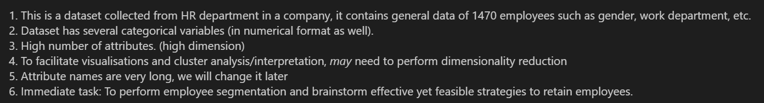
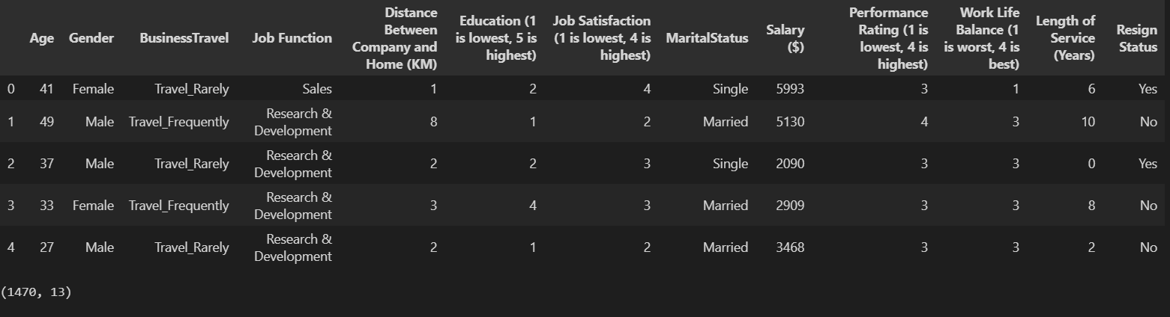
Dataset Info

Slide 7
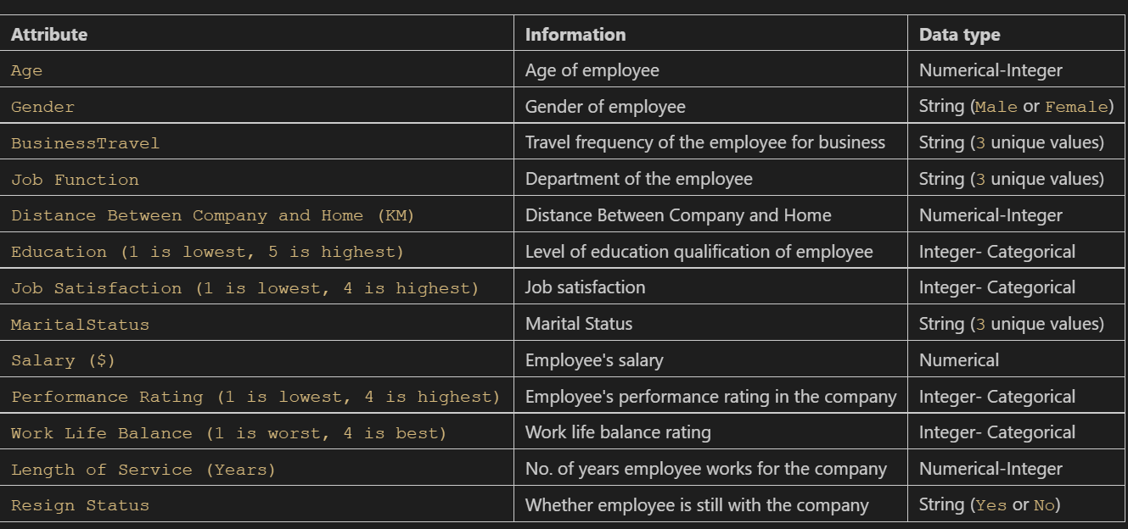
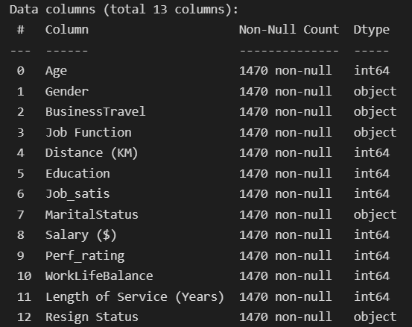
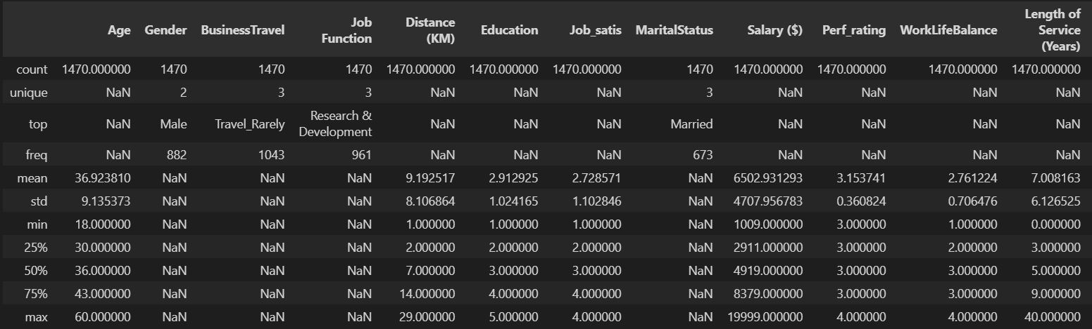
Exploratory data analysis
Rename column to shorter name
No missing values which is good
Standard deviation for salary is very high, suggesting a large spread where salary vary quite significantly. (drastic jump from 75th percentile to max can be observed as well), suggesting a right skewed distribution, with possible existance of outliers.
To cite specific values, the median salary is 4.9k while the max is 20k.
Two things to note is that an average employee earns around 6.5k, and median may be a better central tendancy to measure salary in this case

Slide 8
Exploratory data analysis
Similar mean and median for age may suggest a symmetrical distribution. Pretty high standard deviation observed from age (9), suggests employees of the organization have somewhat differing ages. One thing to note that the youngest employee is only 18 years old, similar to a student. Moreover, the typical employee is of middle age group, given that 50% of the employees are between 30 and 43 years old.
More males than females in the organization.
6. Distance between home and company seems to follow a slight right skewed distribution given the sharp jump from 75th percentile to max.
7. Longest serving employee at the company has been serving for around 40 years, which is well above the median of 5, suggesting a possible right skewed distribution
Some attributes have very consistent percentiles, this may suggest a categorical variable in numerical format.
Attributes are of widely differing magnitudes, we need to perform scaling, even more so since this is a clustering task.
Generally, we conclude that there are no erroneous or anomalous values.

Slide 9
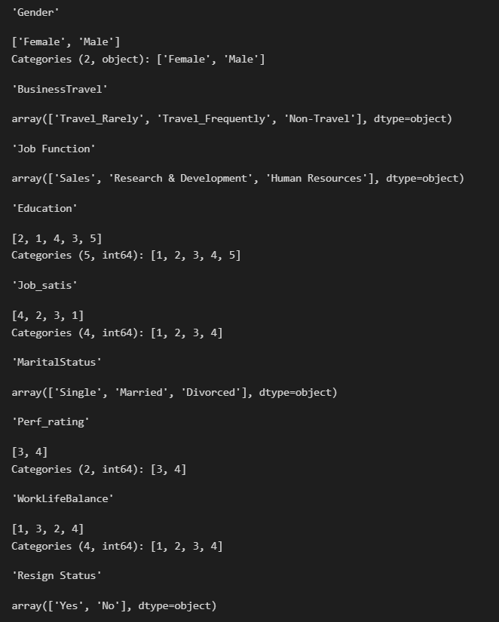
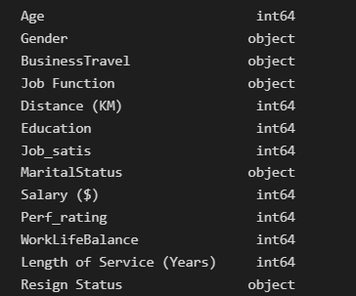
Exploratory data analysis
We are greeted with a plethora of different attributes. For example, we have education which is a categorical variable that is ordinal in nature, and salary which is numerical and continuous in nature.
We notice 9 categorical variables, that are both in numerical and string format, as well as 4 numerical-continuous/discrete variables.
Variables generally represented in correct data types. One thing to note is that there may be some categorical attributes that are in numerical format, for example attributes with ordinal data like `Education (1 is lowest, 5 is highest)` may be `categorical` type. I will go through in detail how we should handle these variables with differing data types later on.

Slide 10
Exploratory data analysis
However, one thing to note is that we may face a few problems given that we have many categorical attributes and fewer numerical-continuous/discrete attributes.
We can brainstorm a few methods to tackle this problem, one method is to use clustering techniques such as using K-Prototypes, or even perform _unsupervised feature selection and statistical tests to determine the relevance and significance of the categorical attribute_. This is also done to reduce the ambiguity of clustering.
Out of all the methods, I deemed most of it to be suitable, especially determining the significance of the attributes, where we also can try to reduce the feature space.
For this study I will use `Label Encoding` for the sole purpose of visualization and not for modelling.
Concretely, I will use Label encoding for EDA, so that we can discover distinct clusters, and also group variables with ease.

Slide 11
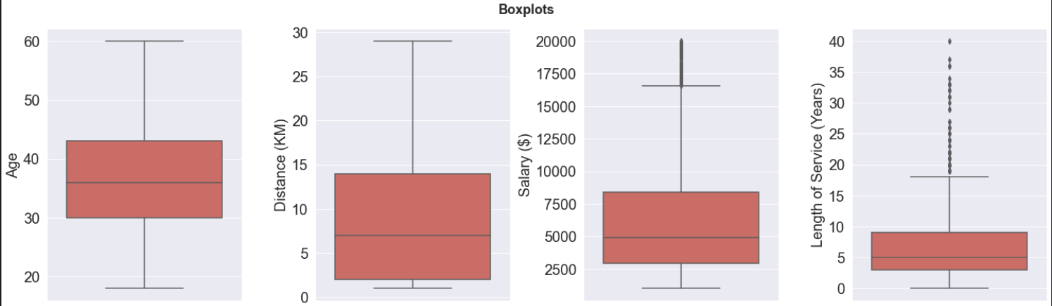
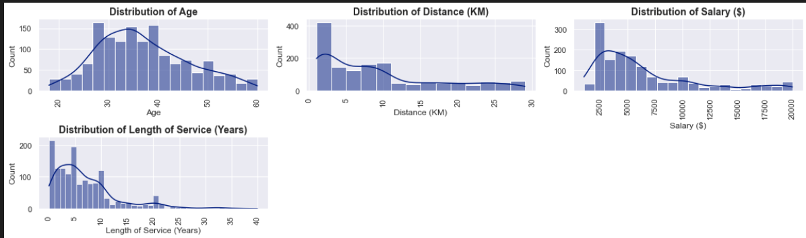
Exploratory data analysis
Attributes are of different magnitudes, which we might need to perform feature scaling later on.
Age follows a multimodel distribution, but the distribution is not consistent. 50% of the employees are aged between 30 and 44 yrs old. Oldest employee is around 60 years old. Age seems pretty normalized and no noticable outliers.
Distance (KM) shows a positively skewed distribution, with no noticable outliers. Median distance in KM from employees house to company is 8KM.
Salary and length of service (Yrs) on the other hand follows a right skewed distribution, given its longer right whisker, median may be a better central tendency for both variables. Furthermore, bonuses and prestigious awards should be provided for employees who served the company for over 30 years, for their loyalty and hard work.
We can see that Salary & Length of service (Yrs) attributes contain outliers, while remaining numerical variables do not really contain outliers/contain very little.
Length of service has smallest interquartile range. Distance KM has the laargest IQR, suggest that the distance from home to company among employees vary significantly
2. Median Salary is around 5000, while max is around 20000, suggests that Salary values varies significantly. Moreover, 50% of employees earn around 2500 to 8000, far away from maximum, which may suggest wages of typical white collar jobs with middle class backgrounds.
Most extreme outlier are from employees that earn around $20000 suggesting that they have significant spending power, employees that have been working for the company for over 40 years are also considered extreme outliers
Since most variables do not follow a normal distribution, it is likely that we are not able to use any distribution-based clustering algorithm, like gaussian mixtures.
StandardScaler may not suitable here as most of the data is non normally distributed , Normalization may be more appropriate

Slide 12
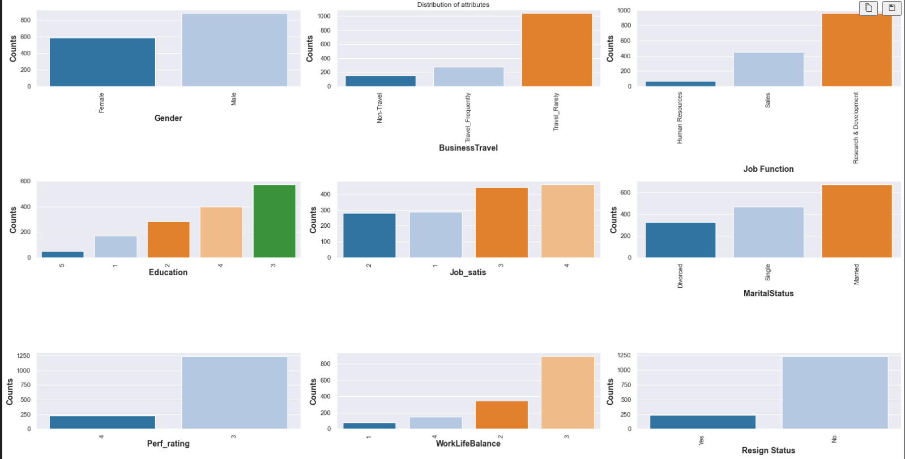
Exploring general features
- We can see an uneven count of each class for the variable of resign status, where there are very little people who resign compared to not resigned (around 5:24 ratio). Hence, it may be hard to get a grasp of the cluster of those who resigned compared to those who did not. Such a scenario could lead to not-so-prominent clusters. Since we want to compare the clusters characteristics, so to further understand the persona and traits of the cluster, we may need to select our clustering algorithms carefully while keeping in mind the mixed data types in the feature space.
- We also note that there are some dominating classes with a much larger proportion count than other classes for some variables. One example is the `BusinessTravel` variable, where there are close to 1000 employees that travel rarely, as compared to 200 who do not travel, and 250 who travel frequently. This may limit the clustering algorithm to account for information of employees that do not travel or travel frequently
- Hierachical clustering may be good & relevant for this study. Some of such algorithms would be agglomerative clustering. Another approach is to select the linkage parameter for hierachical clustering. Like single link, complete link etc.
Most employees have an education level of 3, while there are very few employees with education level of 5 and 1. This may be logical as those with low education level of 1 may not fully have the expertise and skills for the job, hence employees may choose to hire those with higher educational qualifications such as Degree, PHD, etc. Moreover, education level of 5 may suggest employees have specific and specialized skillsets, hence very familiar and proficient in work related to their field. Such employees may be hard to find, which may account for the low count of employees with education level of 5
- There seems to be more male than females in this study.
- A lot more employees that are in research & development department, which may suggest a corporation that aims to develop new services or products, and improving existing ones.
- Most employees are very satisfied with their job and feel that work life balance is generally good

Slide 13
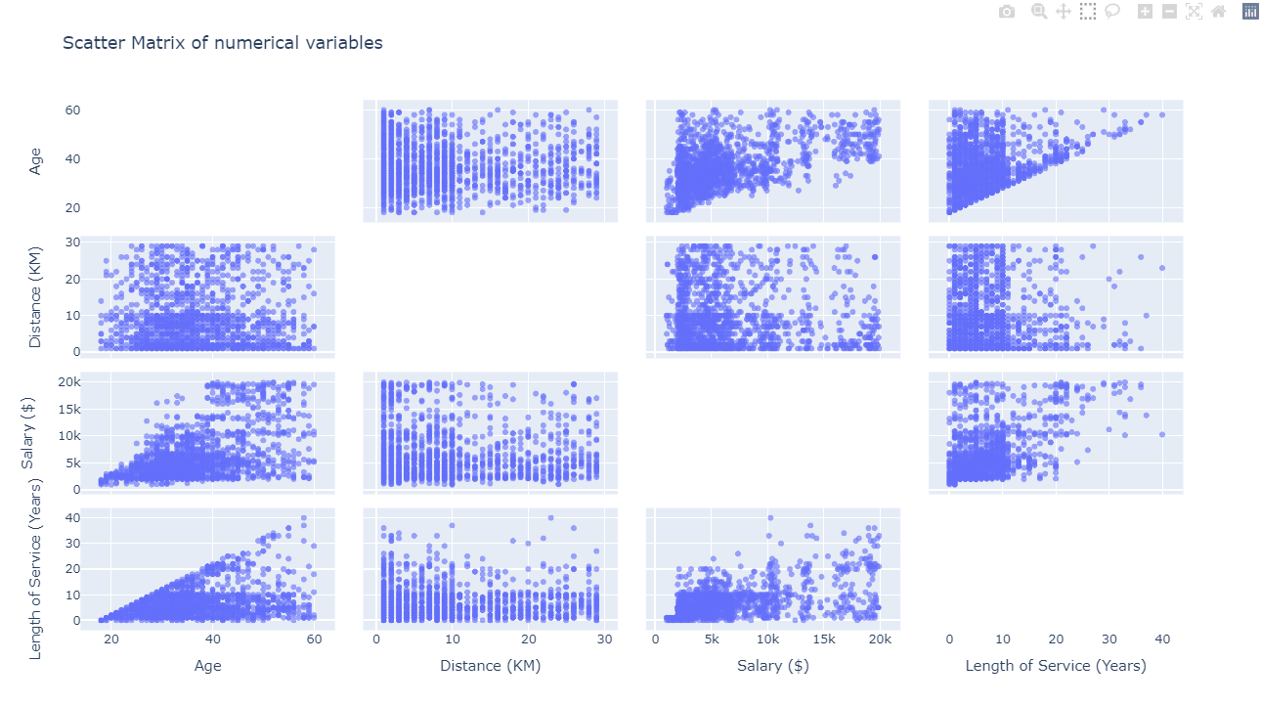
Bivariate analysis
No distinctive clusters or patterns observe among the variables as shown by the scatter matrix. Most observations are close to one another and appear at random. There is no pattern in the scatterplot between variables.
Triangle liked shape observed between age and length of service. This is logical as length of service should not be larger than age.
Employees that have longer length of service tends to have higher salary.
There does not appear to be any visible significant relationship among most variables.
No extreme bivariate outliers observed among the scatter plots of variables that distorts the trend

Slide 14
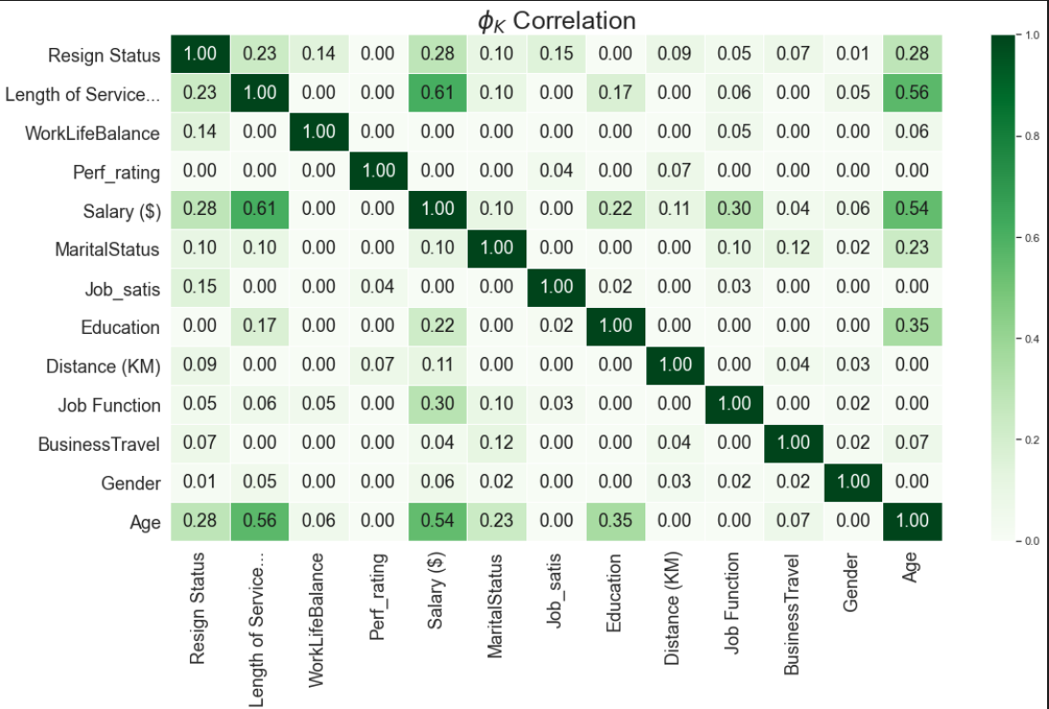
Phik Correlation
Phik (𝜙k) is a correlation coefficient that works consistently between numerical, ordinal variables. This is very useful for this current dataset.
- The correlation ranges from 0 to 1, with 0 having no association, while 1 denoting high association
- We note that there is significant correlation between length of service and salary, with a phik correlation of 0.61. This would be logical as longer length of service will mean richer work experiences, with better and posses a variety of industry skillsets. These experienced employees are what employers are generally looking for, and are willing to pay more for the employee to work with them.
- Age is also moderately correlated with length of service having a phik correlation of 0.56. This is likely due to the fact that the longer one works for the organization, the older the person gets. In other words, they are directly proportional
- Most variables are independant of each other, denoted by its low or weak correlation.
- We might be interested in the variable of `Resign Status` as it corresponds directly to our unsupervised clustering task of understanding employees.
- We immediately note that resign status and age has significant correlation of 0.28, and salary with resign status have a correlation of 0.28 though i expected higher, this is likely due to the fact that old age may mean leaving the organization for retirement thus resigning, whereas perhaps a lower salary may result in employee resignation for better career prospects.
Since there is significant correlation between age and length of service,
and between salary and length of service.
This explains why there is also significant correlation between age and salary

Slide 15
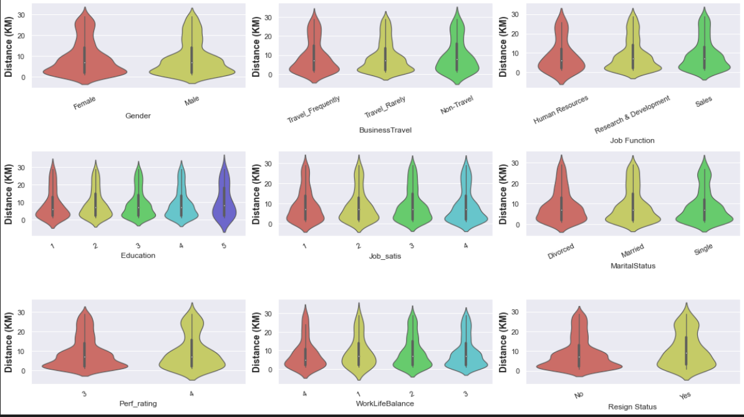
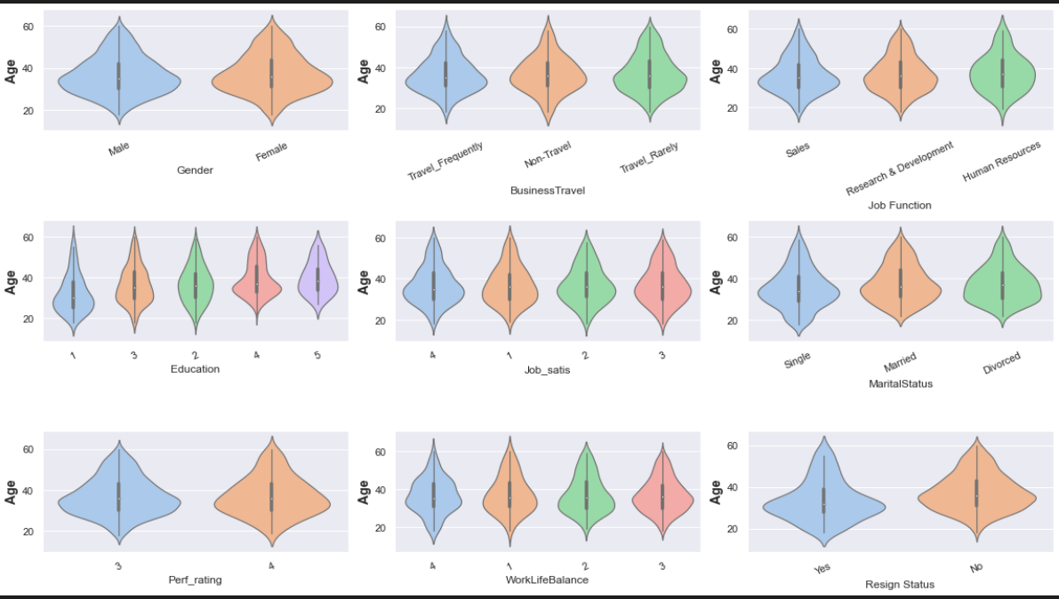
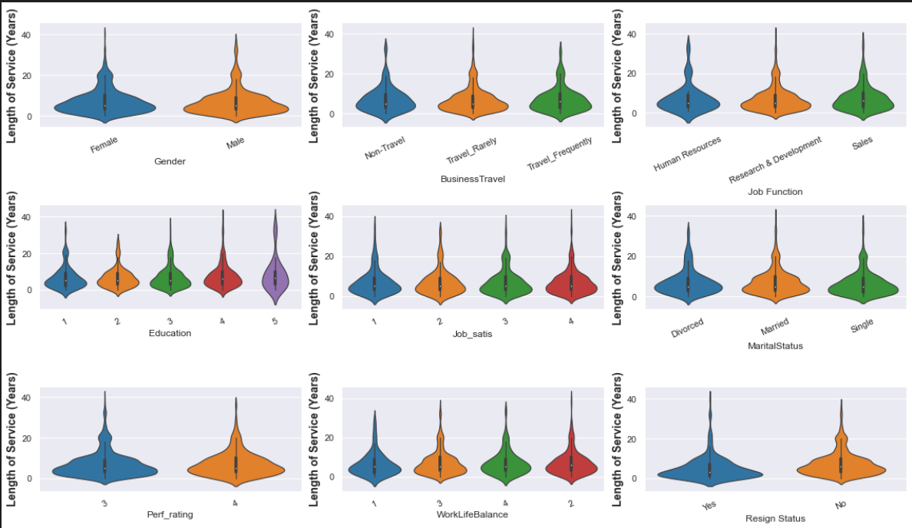
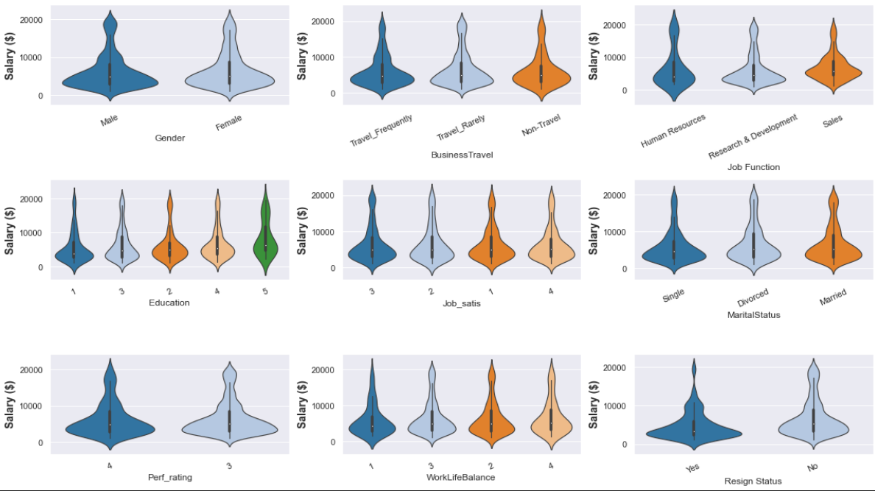
Violin plots

Slide 16
Violin plots
1. Looking at the violin plots, by comparing the distributions groups by age, distance and salary, it appears there is no significant difference between the distributions of males and females for all the numerical variables.
2. Furthermore, variables like job function, there appears to be little significance difference between distributions between the unique groups for all the numerical variables.
3. It is hard for us to make a concrete decision hence, I will be conducting statistical tests like ANOVA to determine if means between groups differ. Ideally, we want to have distinct information in the clusters generated by the algorithms.
Shortlisted Features to conduct tests on
1. I will be conducting statistical tests on a few features namely: gender, Job_satis, WorkLife balance, and perf rating.
2. We will determine if these features have influence on the distribution of the data, and whether it is useful in producing distinct and non overlapping meaningful clusters
3. Since the other variables have different distribution among groups, and also differing medians as indicated by the box plot, we are going to proceed with just the above 4.

Slide 17
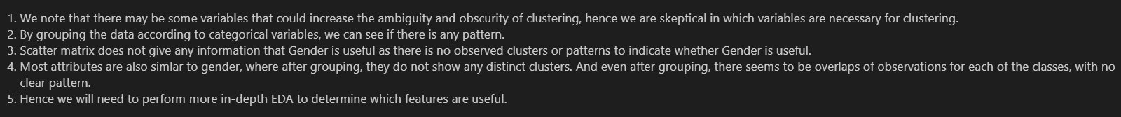
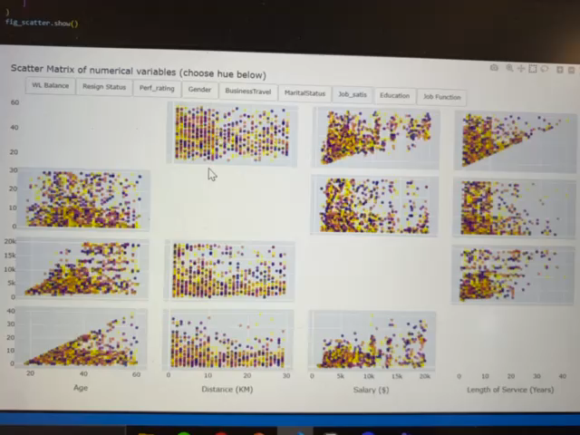
Multivariate analysis

Slide 18
T-Stochastic Neighbour Embedding
`t-SNE` is an unsupervised technique used primarily for data visualization for data of high dimensionality.
It cannot be used as a dimensionality reduction technique
It is a non-linear method, and its goal is to preserve similarity between the data points.
It provides a sense of how our data is represented in high dimensional spaces. Furthermore, we need to pay attention to TSNE visualization if it shows any patterns or distinct clusters
The t-SNE algorithm calculates a similarity measure between pairs of instances in the high dimensional space and in the low dimensional space. It then tries to optimize these two similarity measures using a cost function.
t-SNE can show clear separations in the data. This can be useful before modelling, to pick the no. of cluster.
The output of TSNE cannot be used for clustering as results are not consistent for each run and the result highly dependant on hyperparameters such as perplexity
We need to ensure that the `perplexity` parameter carefully, as selecting too high may not serve the purpose of TSNE anymore.
Why not use `PCA` for visualization?
1. We will not use PCA, as it may not work well with categorical data

Slide 19
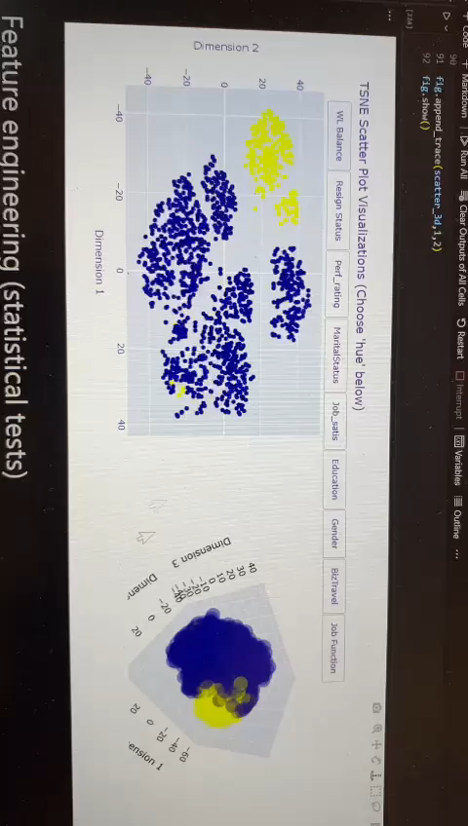
T-Stochastic Neighbour Embedding
- To visualize, I will label encode the categorical variables such as business travel, as TSNE does not accept strings. Furthermore, we will scale the data using standard scaler. **Note that WE ARE NOT LABEL ENCODING FOR THE CLUSTERING ALGORITHM, but for the sole purpose of grouping.**
- There seems to be 4 main clusters.
- The main cluster on the right seems to comprise with multiple unnoticeable clusters.
- After grouping by resign status, there seems to be 2 main groups. Employees that resign seems to take the top left clusters.
- However, grouping by other variables does not result in identifiable patterns or cluster.

Slide 20
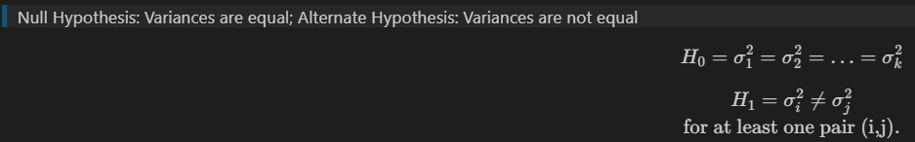
Feature Engineering (Levene test)
1. From the EDA, we clearly noticed that not all variables are relevant in providing distinguishable clusters. Some variables also may increase the ambiguity of clusters. I will then be conducting the ANOVA test to perform feature selection to reduce the ambiguity of clustering
1. We will be using the Levene tests to check for equality of variances for k samples. This is crucial as assumptions ANOVA assumes homogeneity of variance, which means that the variance among the groups should be approximately equal. The levene test can verify that assumption. Levene test will be conducted on significance level of 0.05
> Null Hypothesis: Variances are equal; Alternate Hypothesis: Variances are not equal

Slide 21
Feature Engineering Motivation (ANOVA)
ANOVA uses the f-tests to statistically test the equality of means. We are conducting a statistical test to determine if there is a statistically significant difference between 2 or more groups, by testing for differences of means. Assumptions include homogeneity of variances, and each group sample is drawn from a normally distributed population. We are already using levene test to verify the first assumption. For the other assumption, one-way ANOVA is considered a robust test against the normality assumption. This means that it tolerates violations to its normality assumption rather well so we do not have to worry.
Since there are some attributes with more than 2 unique categories/groups, the ANOVA test would be more relevant than the independant t test.
We want to determine if there is a significant difference between the demographics and habits such as salary/distance etc of the different groups for some categorical attributes. This may help us decide on a course of action for what to do with the feature. ANOVA helps us with that.
There also might be a possibility that the data have redundant information which means that there might be overlapping information after clustering the data, hence producing meaningless clusters. To prevent that, we have to do feature selection using ANOVA
2. If there is equal population means between groups, it means the feature has no significant difference among its groups suggesting that the attribute do not have a huge influence on the distribution of data and hence it (the categorical variable) should be seriously considered for model training.
Ideally, with anova, we want to have features that have an influence on the distribution of data (that is population mean of at least one group is different from the rest)

Slide 22
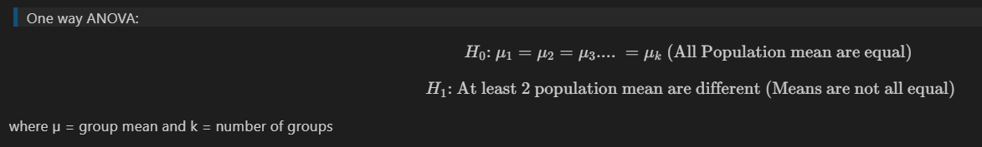
Feature Engineering (ANOVA)
Based on the EDA earlier, (violin plots), we want to select some categorical attributes where the groups have very similar distribution or demographics, where the attribute may not provide useful information to the clustering algorithm.
1. The one-way ANOVA tests the null hypothesis that two or more groups have the same population mean. The test is applied to samples from two or more groups, possibly with differing sizes.
2. We will be using significance level of 0.05. If P-value < 0.05, this means that there would be evidence to reject the null hypothesis.
- Since we want there to be distinct information in the clusters, we want to find population means that do not differ, where attributes do not have a huge influence on the distribution of data. This is so that we can handle these features later on.
- We also have doubts whether features like `Gender`, `Perf_rating`, `WorkLifeBalance`, `Job_satis` are necessary based on EDA, and whether it provides useful information towards the clustering algorithm.
- Some attributes also do not make logical sense as an input to the algorithm. For instance, if we were to feed `Gender` attribute to the algorithm, there would be certain bias in the algorithm output, which violates fairness of the model (also violates Microsoft AI values). From the perspective of a HR manager, why would the gender matter in brainstorming strategies to satisfy and retain the employees. Hence `Gender` as a feature would be inappropriate.

Slide 23
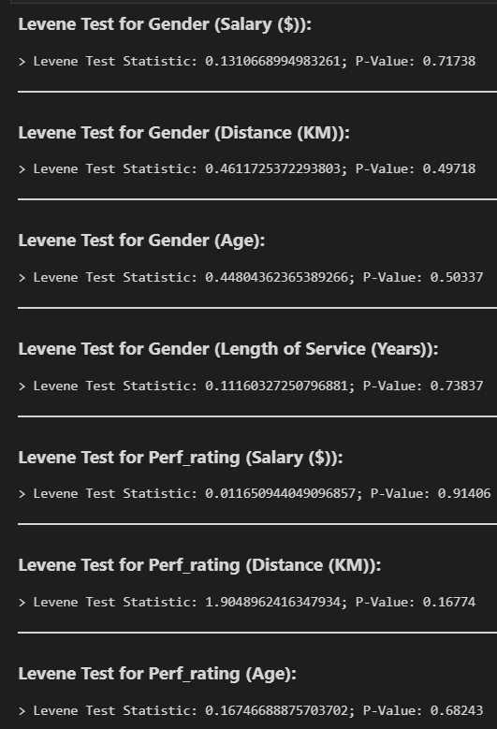
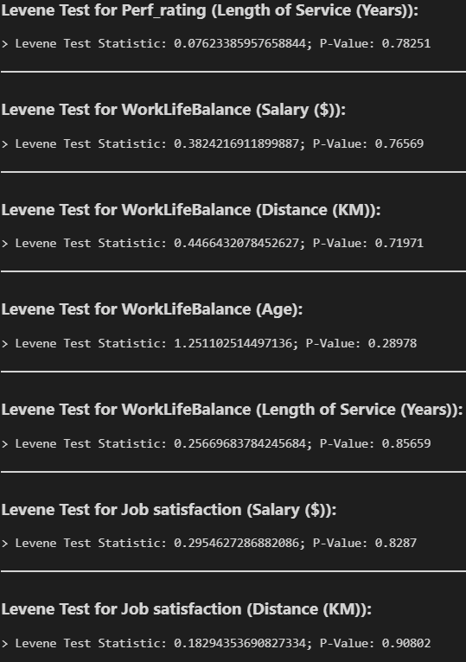
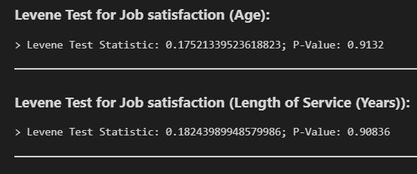
Feature Engineering (Levene Results)
From the levene tests, All of the p value ['Length of service', 'Age', 'Distance', 'Salary'] are above 0.05, this suggests that there is insufficient evidence to reject null hypothesis, and we can conclude that there is equal variance for ['Length of service', 'Age', 'Distance', 'Salary'] between the groups for the categorical attributes. Hence, the ANOVA assumption of homogeneity of variance between groups are fulfilled, we can conduct ANOVA.

Slide 24
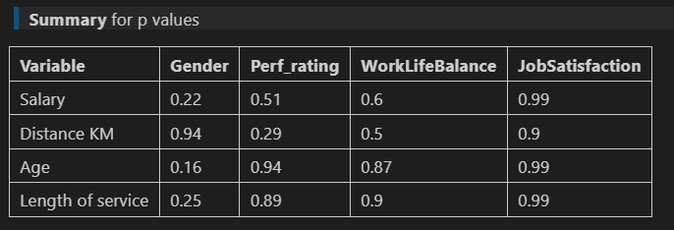
Feature Engineering (ANOVA Results)
1. From the ANOVA test results, all of the p value are well above the significance level of 0.05. Hence, we have insufficient evidence to reject null hypothesis of equal population means. Hence, we can conclude that the population means for the variables across the groups(for all numerical variables) are the same and do not differ.
2. We can conclude that these features do not have significant influence on the distribution of the data. These features are likely increase the ambiguity of clusters formed, and possibly overlapping/undistinct information in the clusters.
These features will not be useful for clustering as different Job statisfaction level, performance ratings, Gender and Work life balance levels, all have similar age, distance to company , salary and length of service on average which might make the clusters more ambiguous.
- Hence, we will drop these features later as they do not provide information that could be useful for employee segmentation
3. Further removal of variables is not ideal has it could lead to less meaningful clusters and information loss about the clusters.

Slide 25
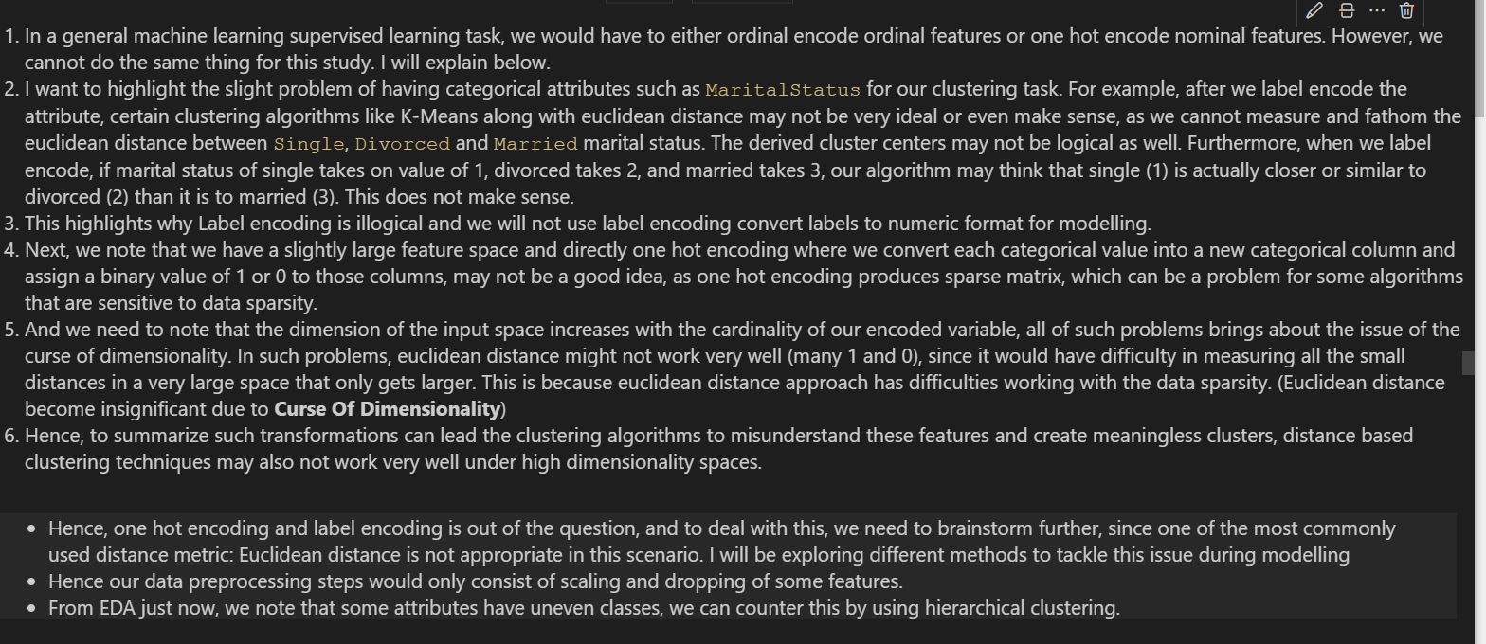
Preprocessing

Slide 26
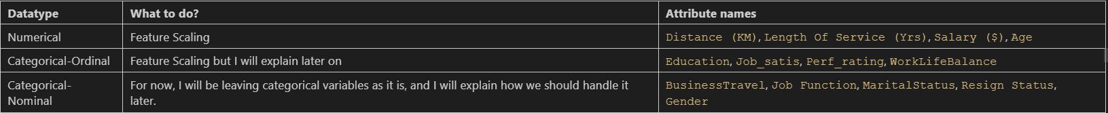
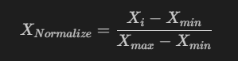
What to do for different types of attributes?
1. We will drop some columns for preprocessing, the ones that are deemed to be less important in reducing the ambiguity for clustering as proved by the tests earlier, and drop features that do not have significant influence on the distribution of the data. (at least population mean of at least one group is different). We note that from the statistical test earlier, 'Job_satis', 'WorkLifeBalance', 'Gender', 'Perf_rating' that are deemed to be redundant and less relevant, which will result in the possible existance of overlapping information in clusters. This highlights why we need to drop these columns
2. Next, we will discuss scaling methods, but before that we need to recognize the importance of feature scaling. That is: numerical features in the final dataset that is used for clustering must be on the same scale for each numerical feature to be treated equally by the distance metrics when measuring similarities. Such will allow no statistical bias between attributes within the clustering algorithm. Hence, we need to perform normalization.
Why Normalization?
3. There are some algorithms such as K-Prototypes that require a different type of scaling namely normalization using `MinMaxScaler()`, min max scaler is able to bring the numerical features within range of [0,1].

Slide 27
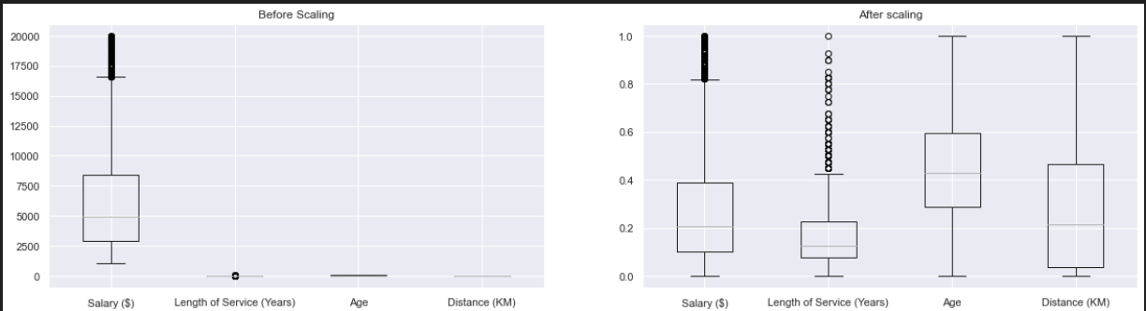
Feature Scaling Visualization
1. We will see how MinMaxScaler transforms our data.
2. Before scaling, magnitudes of certain variables are too small compared to salary.
2. After scaling, we note variables follow similar magnitudes and scale, which is a good thing. Variables are of range [0,1]
3. Original distribution is preserved, similar to what we saw during EDA

Slide 28
Modelling Metrics to determine the quality of clustering technique

Slide 29
How to determine how good out clustering technique is? (Modeling)
- Firstly, we want to have an algorithm that can provide us with somewhat distinguishable and explicable clusters.
- To select the best model, we will need a way to evaluate the models performance. However, clustering is an unsupervised task, so we do not have the target variable. We can use silhouette scores,etc. We could consider common clustering metrics like Davies-Bouldin Index which is defined as average similarity measure of each cluster with its most similar cluster, where similarity is the ratio of within-cluster distances to between-cluster distances. However, Davies Bouldin score may not be very relevant as our data has nominal variables, and hence the metric would not be used. The usage of centroid distance limits the distance metric to Euclidean space.
- Furthermore, we want data points in the cluster to be similar to each other, and dissimilar from data points assigned to other clusters. Typically, the similarity measure is calculated using euclidean distance for numerical, and Jaccard for categorical. However in this case, we have mixed data types. Hence I will explain a special metric used later.

Slide 30
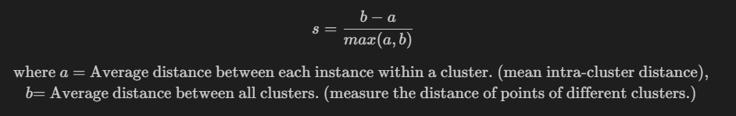
Ideas behind silhouette score coefficient
- Cohesion: Average distance of x to all other vectors in the same cluster. This measures how closely related are
the points in a cluster
Separation: Average distance of x to other vectors in other clusters. Then take minimum among the clusters. This measures how distinct or wellseparated a cluster is from other clusters
The silhouette score has a range of [-1,+1], with 1 being the best.
- (Near) 1: Means clusters are well apart from each other and clearly distinguished.
- 0: Distance between clusters is not significant
- (Near) -1: Means clusters are assigned in the wrong way. It may suggest that the samples has been assigned to the wrong cluster
Silhouette scores is also a good metric especially for high dimensional data. However, since we have several ordinal categorical variable and numerical variables, a special distance metric is more suitable, we do this by specifying `metric=precomputed` in sklearn's silhouette score. We cannot use the default euclidean. Instead we will use Gower's distance.

Slide 31
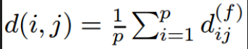
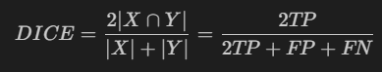
Gower Distance
Specialized hybrid distance for mixed data types
Gower’s Distance can be used to measure how different records (dissimilarity) are. The records may be of a combination of categorical, numerical or text data.
The distance is always a number between 0 (identical) and 1 (maximally dissimilar).
Gower’s distance is computed as the average of partial dissimilarities across individuals
The metric for each data type is explained below
- Quantitative (numerical): range-normalized Manhattan distance
- Ordinal: variable is first ranked, then manhattan distance is used with a special adjustment for ties
- Nominal/Qualitative/Categorical variables: variables of k categories are first converted into k binary columns and then the _Dice_ coefficient is used, the distance is 1 if the categories between two records are different and the distance is 0 if the categories are the same. In other words, dice distance is used for measuring similarity.
We will implement gower dissimilarity using gower library to calculate dissimilarirties between employees.
Ideally, one way to use gower library is to use the gower_matrix function provided, and where we set the parameter `cat_features` to our categorical variables, we will get a dissimilarity matrix. With this, We can apply techniques such as like hierarchical clustering (e.g. AgglomerativeClustering) on the matrix, where the algorithm computes the dissimilarity between all pairs of clusters, then merge the two clusters that are least dissimilar as measured by the dissimilarity metric. To do this, we can use sklearn's agglomerative clustering, by setting `affinity= 'precomputed'`, and tinkering with the linkage criterions. Similarly, we will use algorithms where fitting distance matrix is approrpriate like gower's distance.

Slide 32
Calinski Harabasz Index
- Also known as the Variance Ratio Criterion
- Measures the ratio of the sum of between-clusters dispersion and of inter-cluster dispersion for all clusters, the higher the score , the better the performances
- One drawback is that Calinski-Harabasz index is generally higher for convex clusters than other concepts of clusters, such as density based clusters like those derived through DBSCAN.
> **Note that higher the Calinski Harabasz score indicate better performance suggesting clusters are dense and well separated.**

Slide 33
Limitations of Dice Coefficient
We recall that we have a special scenario of having ordinal categorical data. We need to treat ordinal categorical data as numerical data due to the following reasons:
For instance, education attribute is ordinal in nature, an education level of 5 is higher than education level of 1. Moreover, the difference between education level 1 and 2 is different from the difference between education level 1 and 5. We could say that 1 is more different than 3 as compared to 2. This is the problem with ordinal variables, where the difference between unqiue categories is _different_
Furthermore, since gower distance uses the dice distance as a metric for calculation of dissimilarity for qualitative records, the distance is 1 if categories between 2 records are different, and 0 if categories are the same. This suggest that dice coefficient would be reliable only for data that cannot be ranked (difference between categories of an attribute are the same).
Given this, we need to think of a way to account for the order difference, since dice coefficient is not reliable for ordinal categorical data.
We must cannot treat ordinal categorical variables the same as nominal categorical variable. Instead, we must treat them as numerical variables. In this case, the `Education` variable is first ranked, and then manhattan distance is computed, similar with quantitative variables, but with the special adjustment for ties.
We also recall that we left the nominal categorical attributes as it is. This is because algorithms we will be using later such as K prototypes allows us to specify the categorical columns through `categorical` parameter. Furthermore, when calculating the dissimilarity matrix using gower library, we can also easily set the `cat_features` parameter to our categorical attributes.

Slide 34
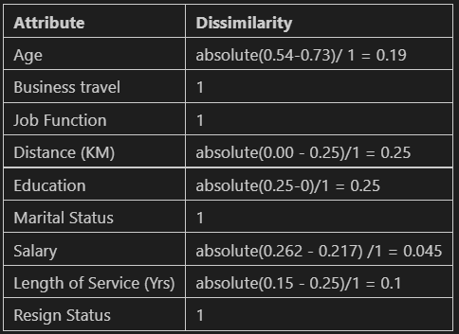
Gower distance calculation example
To calculate gower distance for first 2 employees in the dataset. We have to use the range normalized manhattan metric for numerical (quantitative) data type. Next, the dice distance measures if the attribute if the record are similar for categorical variables

Slide 35
Silhouette Analysis
- Silhouette analysis can be used to study the separation distance between the resulting clusters.
- It helps us determine and assess an optimal value for n_clusters. The silhouette plot displays a measure of how close each point in one cluster is to points in the neighboring clusters and thus provides a way to assess parameters like number of clusters visually. Also from the thickness of the silhouette plot the cluster size can be visualized.
- To facilitate silhouette analysis, we need to reduce the dataset dimensions so that we can plot the silhouette diagram out.
- Hence, we can use several methods such as PCA or FAMD.
PCA:
- Principal component analysis is an unsupervised clustering method which maps the original data space into a lower dimensional space.
- PCA finds a subspace that most preserves the data variance, with the subspace defined by the dominant eigenvectors of the data’s covariance matrix. PCA helps us derive components that explains most of the variability of the dataset. That is preserving maximum variability. The new components can be considered as linear combinations of the original values. It is always recommended to perform PCA on dataset with continuous variables only. _However, our dataset has a mixed of categorical and numerical, hence PCA is not relevant here. What about FAMD?_
FAMD:
- FAMD is useful tool for dimensionality reduction for analysing data with continuous and categorical features.
- Since it is not recommended to one hot encode or label encode categorical data, we will use FAMD to aid us in investigating the results of clustering. It helps us visualize the clusters formed in lower dimensions
- Factor analysis of mixed data does the analysis with a combination of PCA and MCA techniques. MCA stands for multiple correspondence analysis, which is suitable for categorical data. We can use FAMD technique for dimension reduction.
- The categorical variables are transformed into a disjunctive data table and then scaled using the specific scaling of MCA. This ensures to balance the influence of both continous and categorical variables in the analysis. It means that both variables are on a equal foot to determine the dimensions of variability. [Source](https://www.rdocumentation.org/packages/FactoMineR/versions/2.4/topics/FAMD)
- Note that we need to scaling numerical variables before using FAMD. This is critical for valid results. However, prince library already performs scaling for us as seen from documentation. We will be applying the clustering technique on the raw data then using Factor Analysis of Mixed Data via the `prince` library to visualize the clusters. Note that we are not clustering on the output of FAMD.

Slide 36
Silhouette Analysis
We will also use gower distance to determine the quality of clusters formed by the algorithm. Specifically, we will use `gower_matrix` function to convert the original dataframe into a gower matrix, then specify `silhouette_score(gower_matrix,metric='precomputed')`. We pass a gower distance matrix inside sklearn silhouette scores function. We also need to specify `metric='precomputed'` as we are passing the distance array itself. Hence, this will compute the silhouette score.
Since `gower_matrix` from the gower library already helps us scale our numerical variables, we will not need to perform scaling
We will also plot a silhouette diagram to perform silhouette analysis. From the visualization produced by FAMD, we can scrutinize the separation distance between the resulting clusters. On the other hand, the silhouette plot shows how close each point in a cluster is to points in other clusters.
It will allow us to assess the quality of clusters formed so we can take appropriate action to perform further improvement for the clusters of low quality and explicability. I will suggest further improvement steps in the model improvement stage. Next, I will also be using a series of metrics as explained earlier, like silhouette coefficient of cluster, calinski harabasz index along with other appropriate metrics to support the analysis. The average silhouette score will be a benchmark for the quality of clusters formed. Note that clusters that are poorly defined would generally have low silhouette score.

Slide 37
MODEL SELECTION

Slide 38
K Prototypes
K-Prototype is a clustering method based on partitioning. Its algorithm is an improvement of the K-Means and K-Mode clustering algorithm.
- Finally, instead of calculating the within the sum of squares errors (WSSE) with euclidian distance, K-Prototype provides clustering cost that combines the calculation for numerical and categorical variables. The cost is defined as the sum distance of all points to their respective cluster centroids.
How does K-prototypes work?
1. We select _k_ prototypes from dataset, one for each cluster, then allocate each instance to a cluster whose prototype is the nearest to it. This allocation is done with considering the dissimilarity measure which is described next. After all instances have been allocated to a cluster, retest the similarity of objects against the current prototypes. If we find that an object is found such that its nearer to another cluster prototype, update the prototypes of both the clusters. We repeat this step until there is no changes in clusters.
It measures distance between numerical features using Euclidean distance (like K-means) but also measure the distance between categorical features using the number of matching categories.

Slide 39
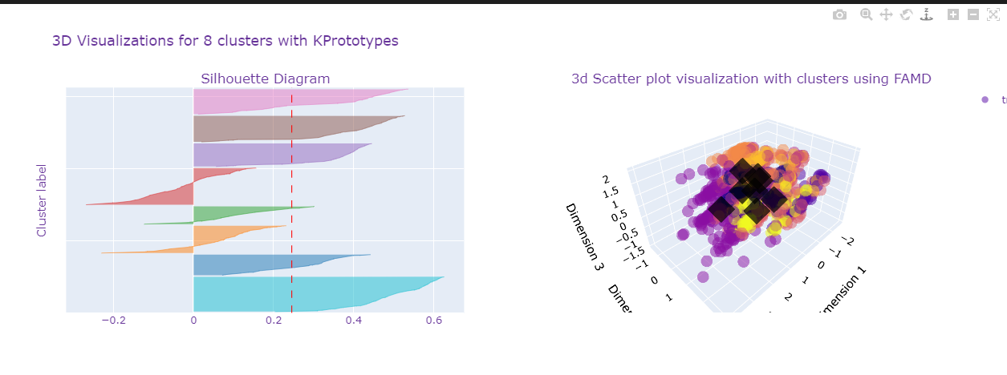
K Prototypes
1. Use of default `n_clusters = 8` parameters, and use the default init = `Cao`. The CAO approach selects prototypes for each data object based on the density of the data point and the dissimilarity value.
2. **We also note that we need to scale the numerical variables before fitting the data.**
2. Perform min max scaling (normalization) on numerical features before fitting k prototypes
3. Specify categorical attributes using `categorical` parameter
Observations
Cluster sizes are not all even, some clusters are too small, which may suggests there are too many clusters. For example, the brown cluster is too small. The light blue cluster seems to be quite well defined
- There are some points that have negative silhouette score, which may suggest that data point is assigned to the wrong cluster. For example, half the data points in the red cluster have negative silhouette score.
- For the red and orange cluster, the silhouette score is below average (does not cross the red average line) with most data points with negative silhouette score. This indicates that the cluster are poorly defined, of low quality.
- The purple cluster as seen from the scatter plot seems pretty well defined, where the other clusters tend to 'mix' in the middle, being quite close to each other. Generally, there is some separation among clusters
- In general, clusters seem to be quite close to each other and possibly overlapping which suggest that clusters are not very well defined, this is likely due to the large dataset size, and too having too many clusters
- Clustering Cost (370), which Sum distance of all points to respective cluster centroids is moderately low which is good. Silhouette score is 0.24, where the distances between cluster may not be very large.
- We will need to opt for model improvement later on to find suitable number of clusters

Slide 40
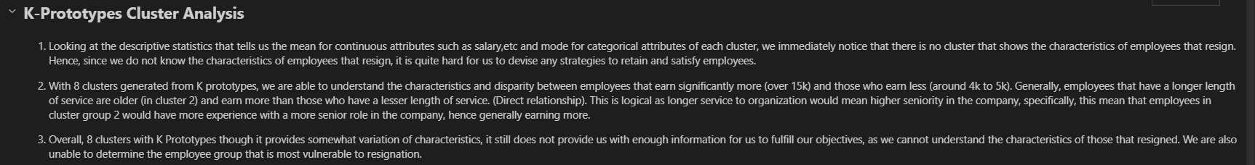
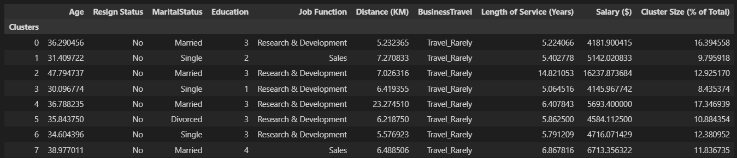
Descriptive statistics of each K Prototype cluster

Slide 41
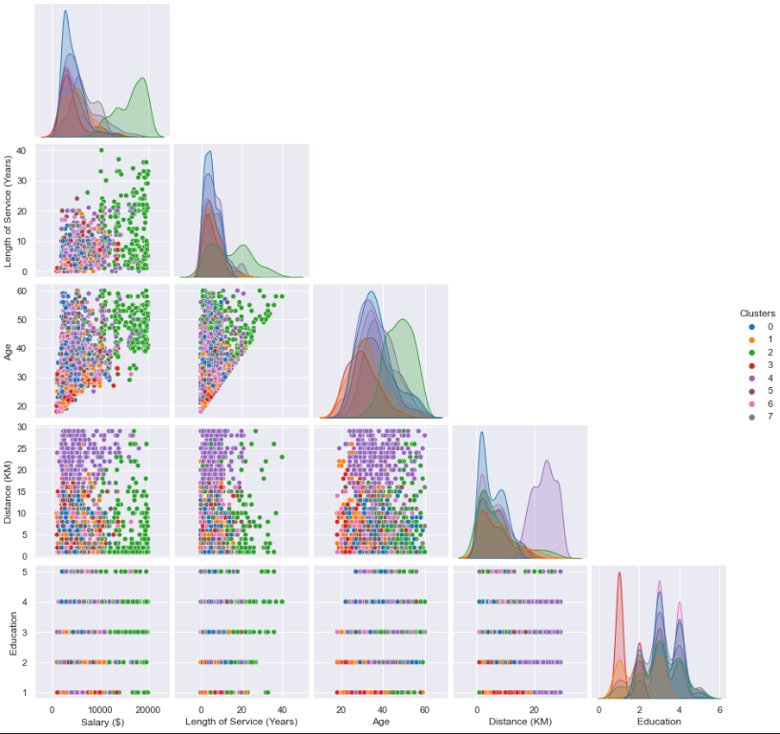
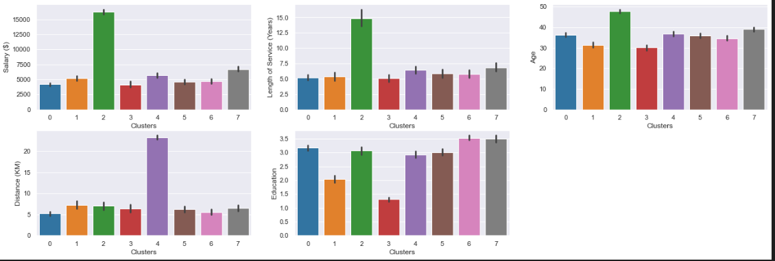
Visualizations of each K Prototype cluster
Pair Plot
1. Looking at the pair plot, we note some ambiguous non circular clusters forming, which suggest K prototypes is a good algorithm, however, we still need to further improve on it.
Bar Plot
1. Cluster 2 seems to describe employees that are slightly older in age, and longer service to the organization. They are also the group of employees that earn the most among all the other cluster groups. Cluster 2 employees earns on average 16k.
3. Lastly, cluster groups 4 contain employees that live the furthest away from company
4. Overall it is hard to determine which employee cluster is succeptible to resignation

Slide 42
Visualizations of each K Prototype cluster
Pair Plot
1. Looking at the pair plot, we note some ambiguous non circular clusters forming, which suggest K prototypes is a good algorithm, however, we still need to further improve on it.
Bar Plot
1. Cluster 2 seems to describe employees that are slightly older in age, and longer service to the organization. They are also the group of employees that earn the most among all the other cluster groups. Cluster 2 employees earns on average 16k.
3. Lastly, cluster groups 4 contain employees that live the furthest away from company
4. Overall it is hard to determine which employee cluster is succeptible to resignation

Slide 43
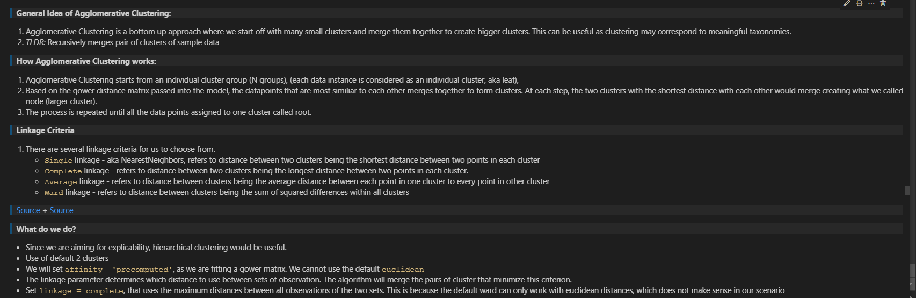
Hierarchical Clustering with gower

Slide 44
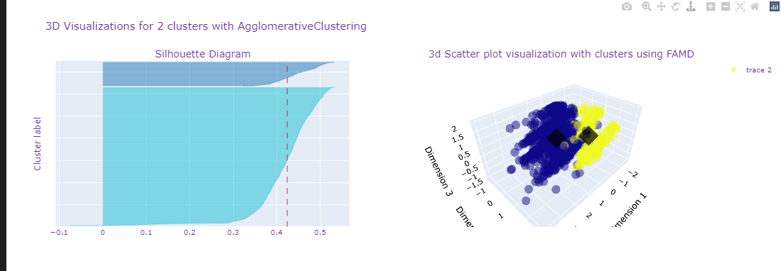
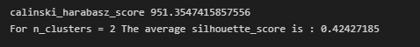
Hierarchical Clustering Analysis
From the silhouette diagram and 3d scatter plot:
1. We can see that clusters are of widely differing sizes, with silhouette scores generally above average. There is a single data point in the blue cluster with negative silhouette score, where it could be wrongly clustered.
2. Clusters are generally distinct and somewhat separated which is good as seen from scatter plot, and cluster centroids are quite far apart
2. However, we need to take a look at the characteristics of the cluster to determine if there is quality separation with meaningful clusters.
3. The silhouette score is 0.4, which is quite good, and the calinski harabasz index is also quite high of 950, suggest that clusters are dense and separated.

Slide 45
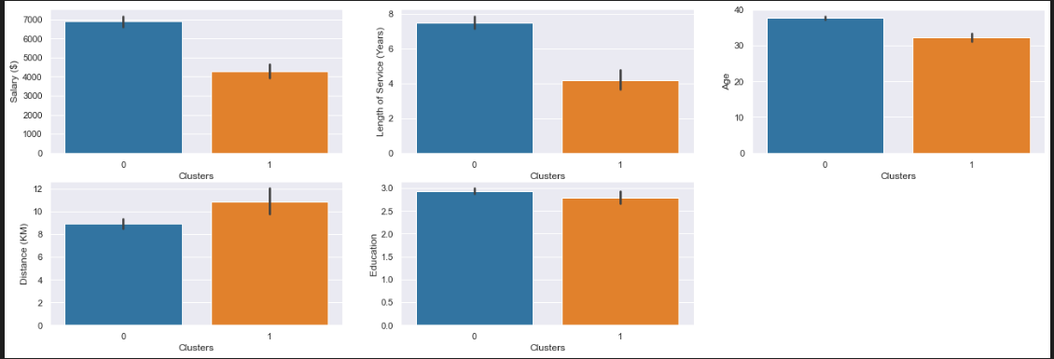
Agglomerative Cluster analysis
From the descriptive statistics and bar plot, we notice that now we can now view the characteristics of the employees that have resigned. We note that they have somewhat lesser salary and lesser length of service than those employees that have not resigned. However, there isnt enough detail of the characteristics that truly separate the 2 clusters.
2. Hence, in other words, the clusters are not informative enough to account for the variety of employees that resign and do not resign. Specifically, the main insight we are only able to tell is the difference in salary of those employees that have resigned and have not. There is not enough distinct and meaningful information to get a grasp of what is the main understanding or reason why the employees resign
3. Hence, I will perform further improvement later by choosing number of k.

Slide 46
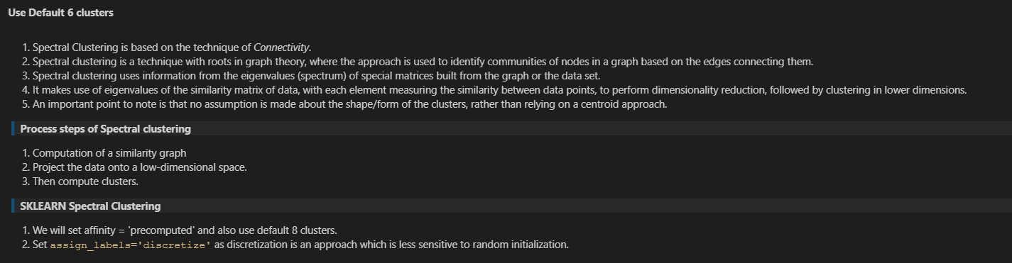
Spectral Clustering

Slide 47
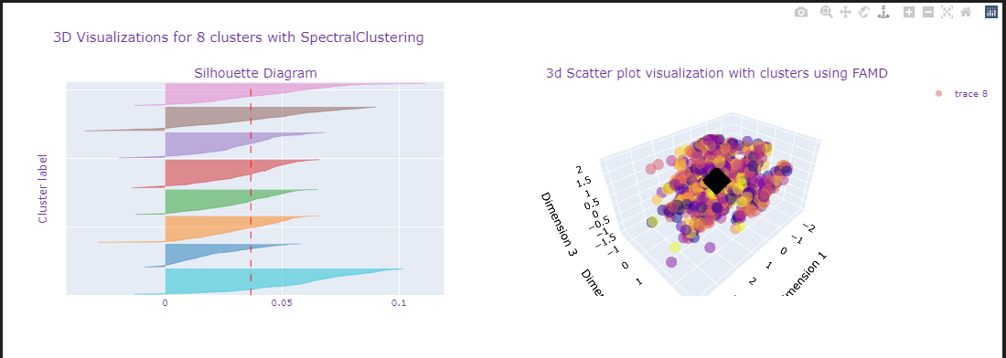
Spectral Clustering analysis
1. We can see that clusters are of similar sizes, with silhouette scores generally not very good.
2. From the 3d scatter plot, the clusters points are at random and overlapping, and there is no clear segregation. This suggests that clusters produced by spectral clustering are not ideal and of high quality. Furthermore, the cluster centroids are overlapping, which would mean that characteristics among the clusters would not allow for meaningful comparison.
3. The silhouette score is close to 0 which means that distance between clusters are not significant at all, and the calinski harabasz index is also very low of an underwhelming 13, suggest that clusters random and not separated.
4. Spectral Clustering is not able to provide us with meaningful employee segmentation.

Slide 48
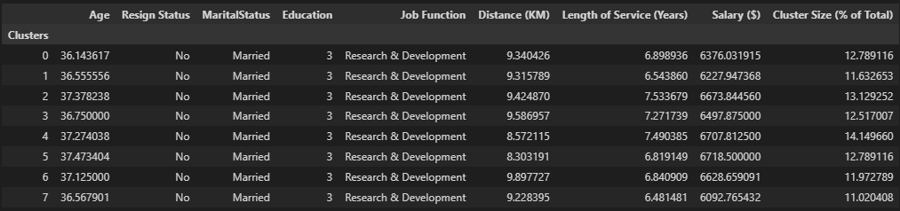
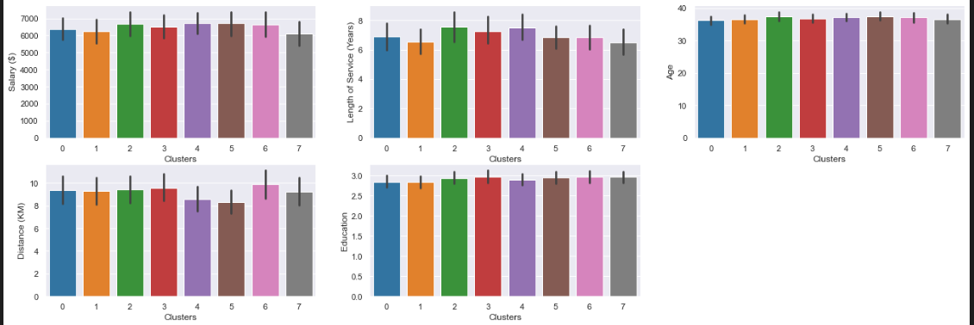
Spectral Cluster Analysis
1. From the descriptive statistics and bar plot, we do not see any significant difference between clusters. We note that the characteristics of each cluster are generally very similar, with no noticable insights.
2. We are unable to tell which employee group is vulnerable to resignation as the cluster labels seems to be assigned at random
3. Hence it is hard to truly devise meaningful strategies to satisfy and retain employees.
PairPlot
1. From the pairplot, there is no significance difference in the distribution of each cluster.
2. Overlapping points

Slide 49
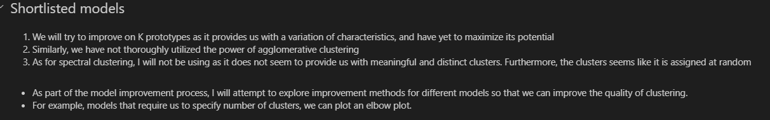
Model Improvement

Slide 50
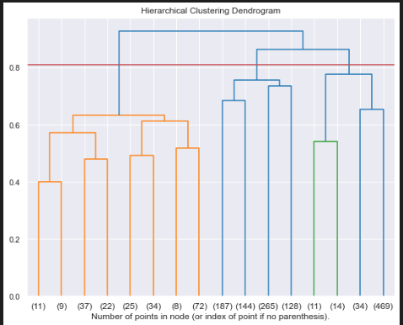
Dendrogram for Hierarchical Clustering
Using the default parameters for agglomerative does not give us any rich and informative clusters. Moreover, from the descriptive statistics, there is no significant difference between the clusters, at most it only distinguishes between employees with slightly higher salary and employees with lower salary.
Hence, it would be hard for us to brainstorm any retention strategies for employees as there is not enough details. Hence we need to search for better clusters.
To search for more quality clusters, we will plot a dendrogram, which plots the distances/dissimilarity between clusters in the vertical axis. The dendrogram is a result of the linking of points in a dataset. We are able to bette visualize the hierarchical clustering or merging process.
2. With a dendrogram, we can select the number of clusters by drawing a line to cut the dendrogram when the clusters formed start becoming too similar. We can use a dendrogram to visualize the history of groupings and figure out the optimal number of clusters.
3. Finding a good number of clusters is the same as finding the largest verical distance space that does not have any horizontal lines (which is the separation of clusters). This means that there's more separation between the clusters.

Slide 51
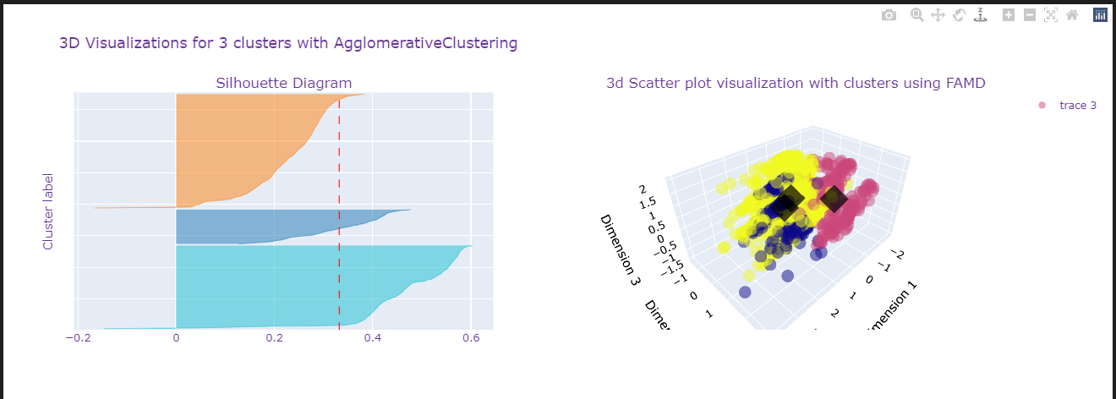
Hierarchical Clustering for k =3
1. When K = 3, we note that the orange cluster is somewhat below average given that it is below the average silhouette score. Negative silhouette score for some data points is observed from the orange and blue cluster
2. Furthermore, there is a uneven size of clusters, with the dark blue cluster being the smallest size.
3. From the scatter plot, the yellow and dark blue clusters seems to be largely overlapping, however, there seems to be some separation among the pink cluster.

Slide 52
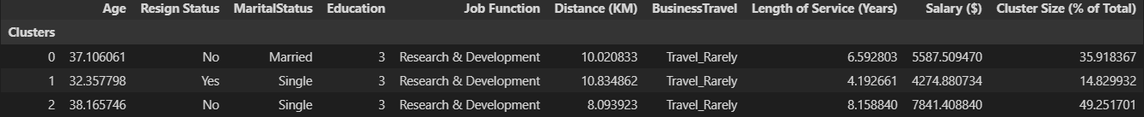

Hierarchical Clustering for k =3 (Cluster analysis)

Slide 53

Selecting optimal clusters for K Prototypes
Initially, we found out that the default number of clusters, (`n_clusters = 8`) did not provide quality or meaningful clusters. Some problems include the cluster size being too small, given that the thickness of silhoette plot is inconsistent among the clusters. There are some clusters with thick, while other clusters are quite large. Furthermore, from the scatter plot we noted that there were significant overlapping clusters. However our dataset is quite huge in terms of rows, hence this may be a issue for most models.
We also noted that some silhouette coefficients were negative, hence instances may be wrongly assigned, hence clusters may not be well defined.
3. Given these issues, our clusters may not be very distinct, as such interpretability and explicability may be an issue.
We will first plot an elbow plot to find the optimal number of clusters. The elbow plot is the clustering cost (which is defined as the sum of distance from each instance to its centroid), as a function of the number of clusters
2. We need to record the clustering cost of K-prototypes clustering from .cost_ attribute, as the number of clusters increase. As mentioned, the lower the cost, the more tightly packed the cluster is. However, the clustering cost obviously would decrease with an increase of clusters. Hence, we want to find the point where the elbow plot flattens (shows elbow shape). This is where the decrease in clustering cost slows down (stops dropping fast), which would mean that the optimal number cluster would be around that area, and increasing more would not provide significant improvements

Slide 54



K Prototypes (K=4)

Slide 55


K Prototypes (K=5)
For k =5, we are able to derive the same set of cluster characteristics as of k =4. Uneven cluster size is also observed as seen from thickness of silhouette plot. However, orange cluster in the corner of the scatter plot seems pretty well defined Likewise, we are not able to understand employee groups that have resign.

Slide 56


K Prototypes (K=6)
Overall, K =6 gives the best variation in characteristics, while k =4 has a decent silhouette score of 0.24

Slide 57
K Prototypes (K=6)

Slide 58




Unsupervised Feature selection
Clustering cost Silhouette score Line plot

Slide 59


Exploring best feature subset when k =5 (without distance (KM)
1. We immediately notice that when k =5, without distance KM, most of the clusters are of even size, with most clusters being well defined, given that they are above average. Silhouette score is 0.27, which is a good improvement from the original subset of features.
2. From the scatter plot, we note that the clusters are more separated now.
3. However, from descriptive statistics, we are still not able to find the group of employee that is the most vulnerable to resignation hence k =5 does not help us fulfill our objectives, hence we will try k = 6

Slide 60


Exploring best feature subset when k =6 (without distance (KM)
We note that each cluster have some data points that have negative silhouette score, suggest that instances may be assigned the wrong way
2. For k =6 and with the distance KM removed, we obtained a silhouette score of 0.29, higher than the silhouette score when k =5 which is a very good sign. Furthermore, the clustering cost is also pretty low.
3. All of clusters are of above average, given that they are beyond the average red line, with the purple cluster being the most well defined
4. From the scatter plot, we note that the clusters are no longer overlapping in the middle, and there is significant separation between most clusters now.
5. Overall, this is a huge improvement from our original feature set, and is significantly better than k =5, since it has higher silhouette score.

Slide 61
Exploring best feature subset when k =6 (without distance (KM)
1. From descriptive statistics, we can finally understand the employee groups that have resigned, hence we are now able to further analyze and derive strategies to satisfy and retain employees
2. We also note a great deal of variation of characateristics among clusters, this suggests that the clusters are distinct and little occurance of overlapping information.
3. In other words, the clusters are very informative, and is able to account for the variety of employees that resign and do not resign. There is a presence of distinct and meaningful information for us to compare
Overall, k prototypes with 6 clusters and without distance KM provides us with significant and quality/well defined non overlapping clusters.

Slide 62
Final Model and interpretation
We will be selecting our final model to be K-Prototypes with 6 clusters, with features including ['Age Resign Status MaritalStatus Education Job Function Length of Service (Years) Salary ($) BusinessTravel’]. Overall, k prototypes with 6 clusters and without distance KM provides us with significant and quality/well defined non overlapping clusters. Furthermore, it possess the higher silhouette score than k =5. Hence, this will be our final model
I chose K-Prototypes over Agglomerative Clustering because although Aggloremative Clustering returned a good of silhouette score of 0.3, there isnt enough distinct information among the employee clusters, suggesting that it will be difficult for us to devise customised and personalized strategies to satisfy and retain employee vulnerable to resignation. our final model K prototypes finally has a silhouette score of 0.28

Slide 63


Final Model and interpretation

Slide 64
Recommendations
1. We will draft out recommendations and strategies to retain and satisfy the group of employees most vulnerable to resignation
2. Most vulnerable group of employees is the employees from the seocnd cluster:
As a HR manager we can suggest some recomendations
1. Since the most vulnerable employee cluster prone to resignation are likely to be fresh graduates and may not know their ideal job scope or function related to their studies. Hence, the company can implement a job rotation flexibility where employees get to learn what other employees from other job functions (related to study) get to do on a daily basis. This would be offered to employees of below age 30 and have been around for 3 years in the company. Such can help the employees to explore different roles and task, and better suit their needs and intersts. With such a flexibility, the employee would be more satisfied and certain of the task or role they want to work in related to their studies. This can encourage employee loyalty and reduce attrition rates.
3. We can also assure the employees of career progression in the company and the chances of job promotion once performance or results they produce are good. With this, the employees would be more motivated and would feel that their efforts are properly appreciated and valued. This will increase employee loyalty
4. Company can also introduce a mentorship programme, where employees are paired with a mentor, where the mentors can offer guidance and tips. This is a win win situation as we note that the employee who tend to resign are usually fresh grads, hence with proper guidance and supervision, the fresh grad employees would feel a sense of belonging and would not feel left out, simultaneously increasing cohesion among the company. This can reduce attrition rates.
5. Offer a competitive compensation. it is essential for the company to pay employees competitive compensation, which means employers need to evaluate and adjust salaries regularly. We can see that this employee cluster that is vulnerable to resignation has significantly less salary than those who do not resign. With adjusted salaries, employees can look forward to better financial security, and do not have to worry about bringing food onto the table. The company can also look into giving enticing healthcare packages and benefits.

